Slide 1
Power Monitoring Solution

Slide 2
Significance
Improving energy efficiency is one of the main challenge for a sustainable Business.
Becoming or continuing to be economically competitive in the marketplace, requires reducing the cost of production.
Significant energy and money can be save through Energy Management.
It is an important tool to help organizations to meet critical objectives for their short term survival and long term success.
Energy Management helps management to accurately monitor and control the cost of operations and take decision for future expansions & Interventions for energy efficiencies.

Slide 3
Greenhorn to Continual Improvement
It is first step towards the continual improvement for energy efficiencies and cost saving.
Based on the Data provided by this system, number of Interventions can take place for Cost cutting and controlling the processes of industry.
The difference of the energy performance index will be assessed before and after each intervention.
Results will show economic costs and the percentage improvement for each intervention, highlighting and allowing for the comparison of energy consumption reduction and relative costs.

Slide 4
Key Stakeholders
Within the organizations/Industries following Departments will be the key stakeholders of this system
Top Management
Production Planning Department
Cost Control Department
Engineering Department
This system will help above listed each department for better decision making, analyzing the performance, Planning and Controlling the cost of operations and for future Interventions to improve the energy efficiency of system.

Slide 5
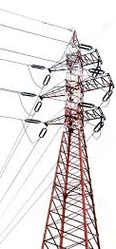
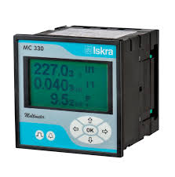
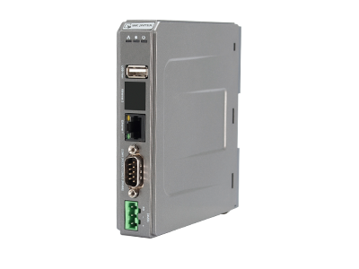
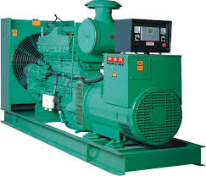
SYSTEM Architecture
Mains
Iskra Measuring Center
Interface Module
Iskra Measuring Center
Industrial Machines
Generator
Iskra Measuring Center

Slide 6
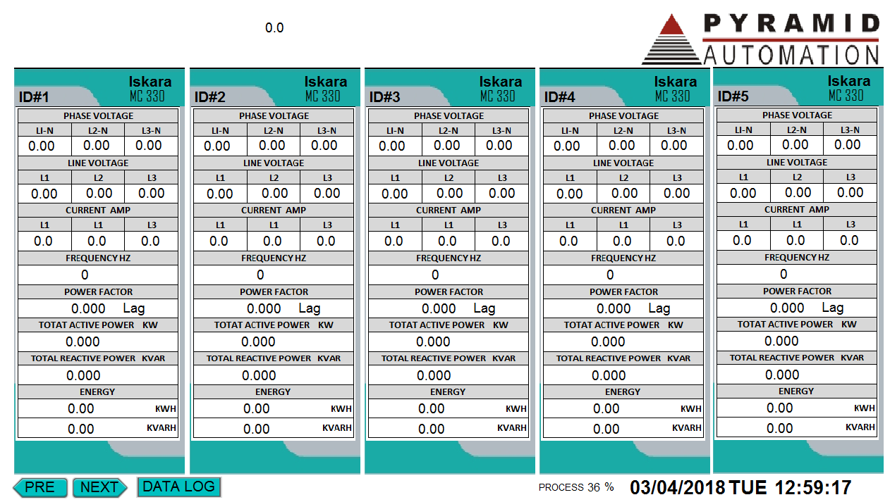
Dashboard
This Page will shows online real-time data on computer screen.

Slide 7
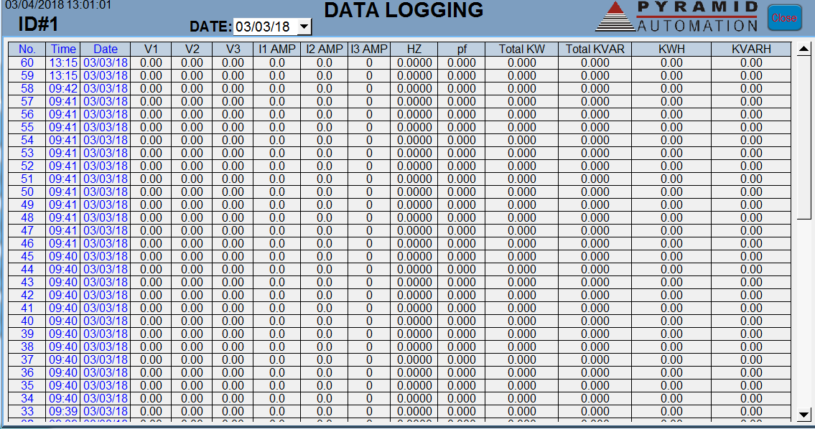
Logs / Reports
Complete data with date and required time interval is available on this page.

Slide 8
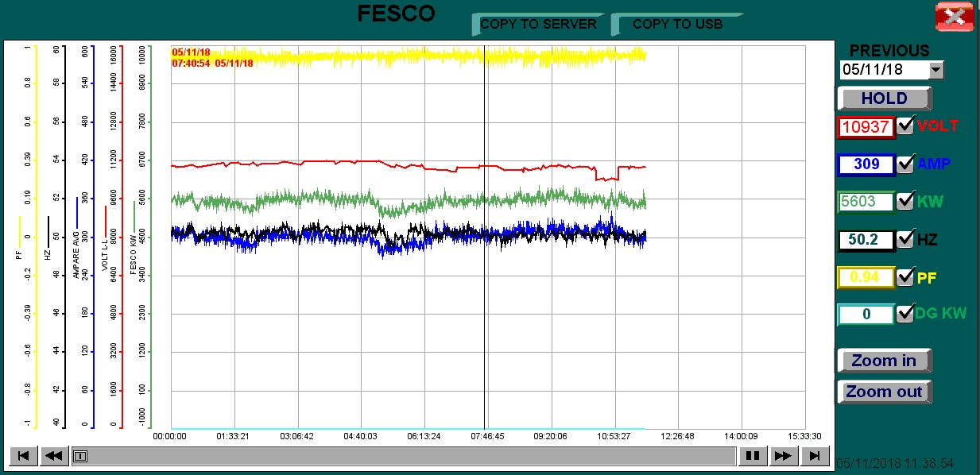
Trend
This page will show each controller data in graphical view of selected parameters

Slide 9
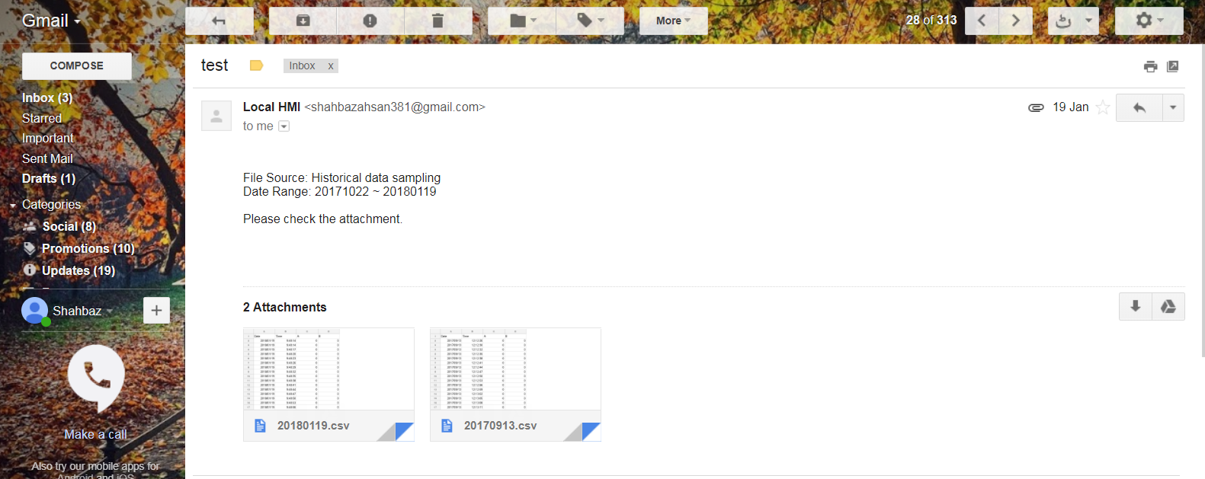
Reports by Email

Slide 10
Benefits & Advantage
Cost Analysis of Generator Vs Mains
Monitoring of Power Quality
Accurate Energy consumption Monitoring and Control
Helps to take decision for intervention for Energy Efficiencies and Operations cost saving.
Data Logging of required Parameters & Alerts
Automatic and Customizable system reports & alerts
Customizable graphical user interface
Emails Alerts
Daily / Weekly & Monthly Reports for Auditors

